Slide 1
A beginner’s guide to GIS in R
Ann-Ida Scheiber Gyllenspetz
PhD Student, School of Public Administration
University of Gothenburg

Slide 2
What we’re going to do
Talk: Basic concepts and things to know
Practice: Basic spatial analysis and maps

Slide 3
What I know
I taught myself with Google, ChatGPT, Reddit, Github, Stack Overflow, and talking to colleagues
“Qualitative researcher” no prior experience of R, and basic coding and statistical experience – you don’t need that either!
Visual confirmation is the beginner’s best friend

Slide 4
Basic concepts

Slide 5
GIS = Geographic Information System, i.e. a program that can connect data to geographic locations and visualize it.
Geographic data/geospatial data/geodata = information that describes places or aspects of places on Earth (or in space)
Geospatial analysis = using GIS and geodata for e.g. measuring the distance between Borås and Jönköping or predicting ambulance readiness based on microclimate and infrastructure data.
R + SF is a GIS!

Slide 6

Shapefile (.shp). The data file you need to reference the Earth.
There are other formats too (like GeoPackage and GeoJSON)
One thing to keep in mind with .shp-files…

Slide 7
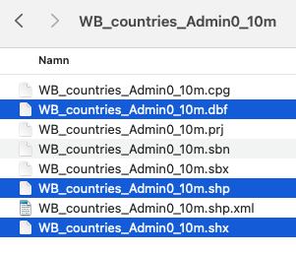

Slide 8
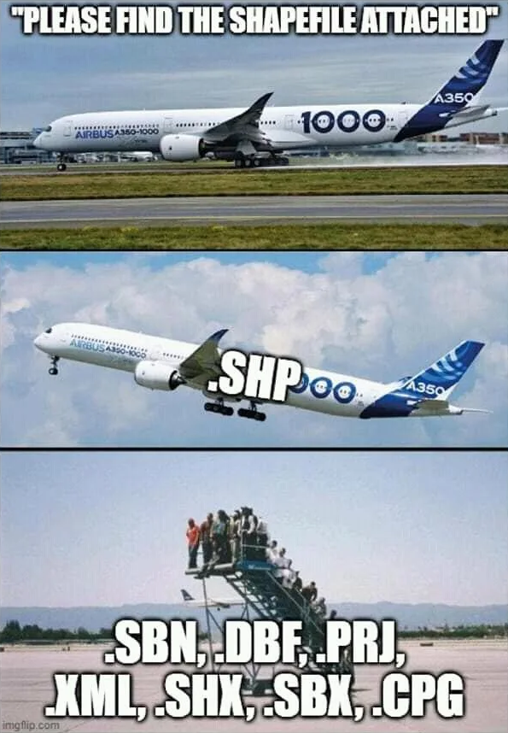

Slide 9
Point
Line(string)
Polygon
Multipolygon
x, y
x, y
x, y
x, y
x, y
x, y
x, y
x, y
x, y
x, y
x, y
x, y
x, y
x, y
x, y
x, y
x, y
x, y
x, y
x, y
x, y
x, y
x, y
An x, y point
E.g. the center point of a city
Several connected x, y points
E.g. a road
Connected and closed x, y points
Also has an area
E.g. a municipality
Multiple connected and closed x, y points
E.g. a municipality consisting of islands
A property enclosing a lake

Slide 10
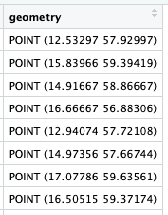
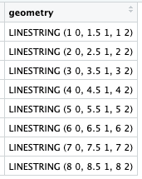
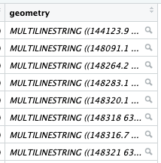
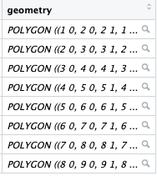
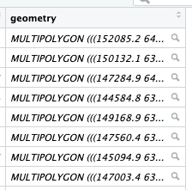
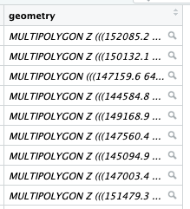

Shapefiles can store different types of geometrical data:
X, Y, Z

Slide 11

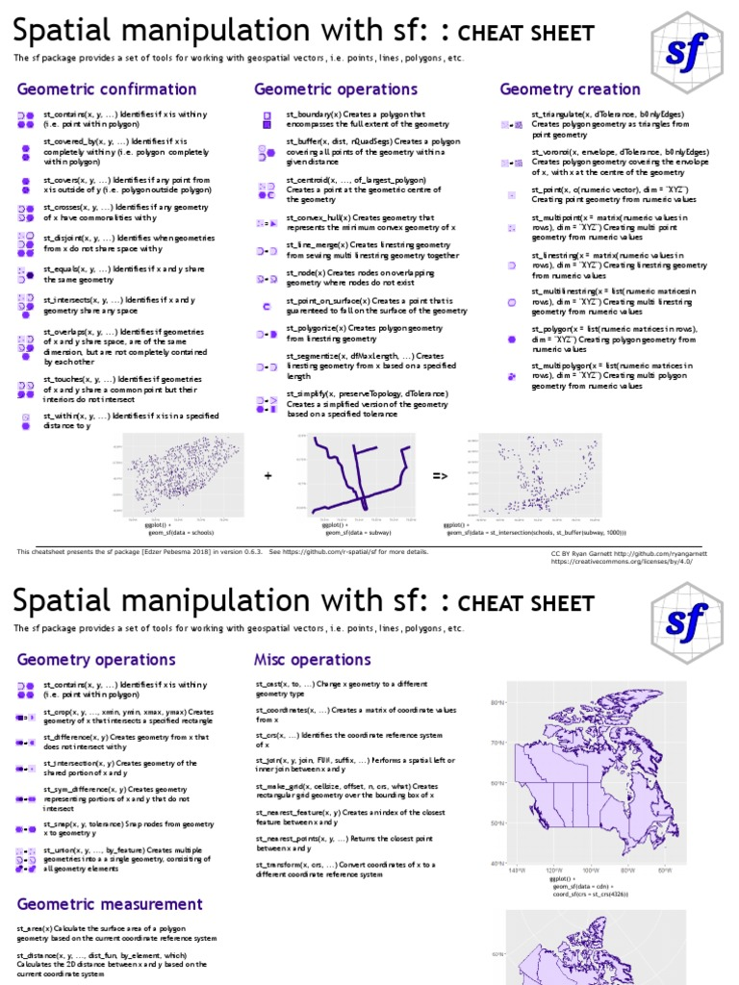
What we can do with geodata in R
SF package for R (there’s leaflet, ggspatial, etc. too)

Slide 12
What we can do with geodata in R+sf
See if areas cover, intersect with, cross, equal, overlap, or touch each other
Make points, polygons, or lines, from geodata or from scratch
Combine areas or subtract areas from each other
Measure distance
Join datasets based on geometrical relationship
+ a bunch of other functions!
E.g., st_make_valid. ”Returns an object with a topologically valid geometry” = usually corrects small errors that you can’t see but which will eventually drive you crazy

Slide 13



+ ggplot for making maps

Slide 14
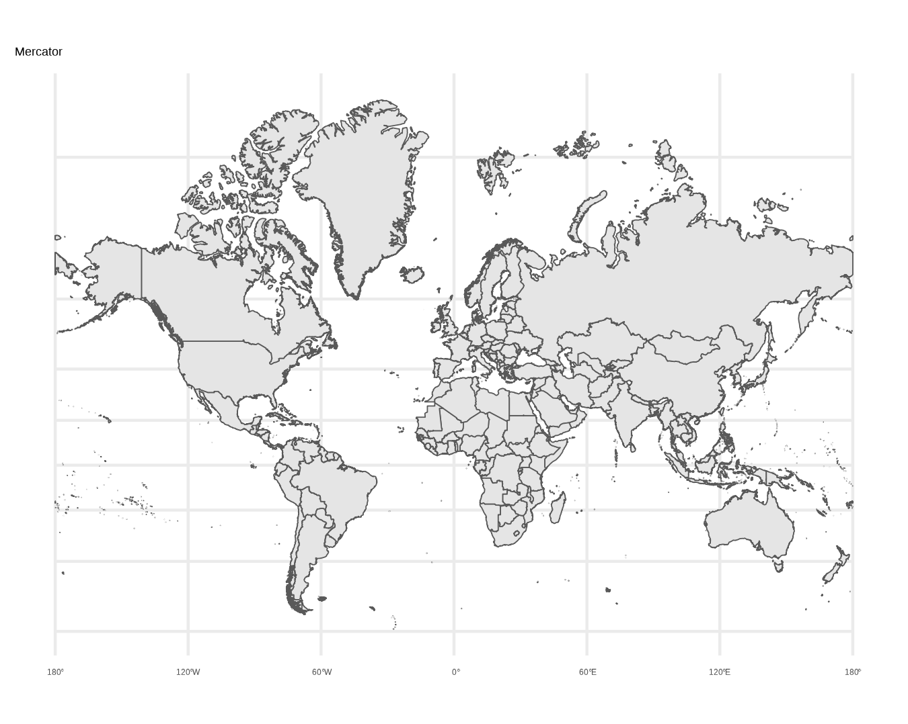
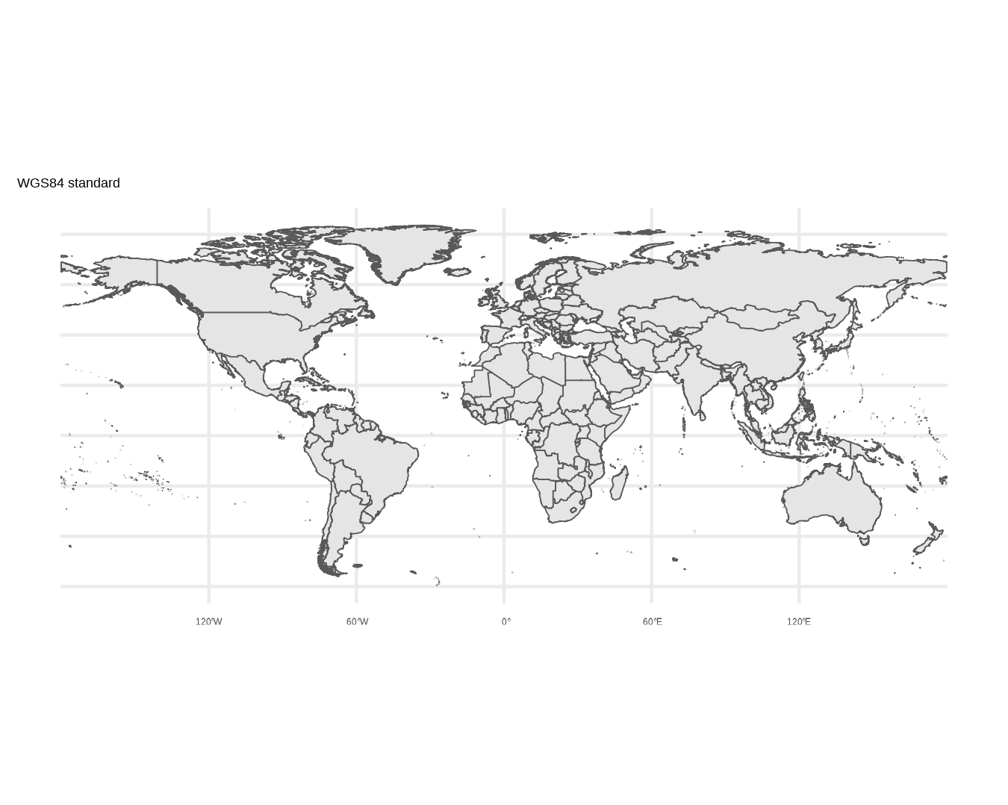
Map projections
WGS84 (EPSG:4326).
A coordinate system, not a projection.
Describes places on a globe using degrees.
World Mercator (EPSG: 3395).
A projected coordinate system.
Describes places on a flat map using meters.

Slide 15
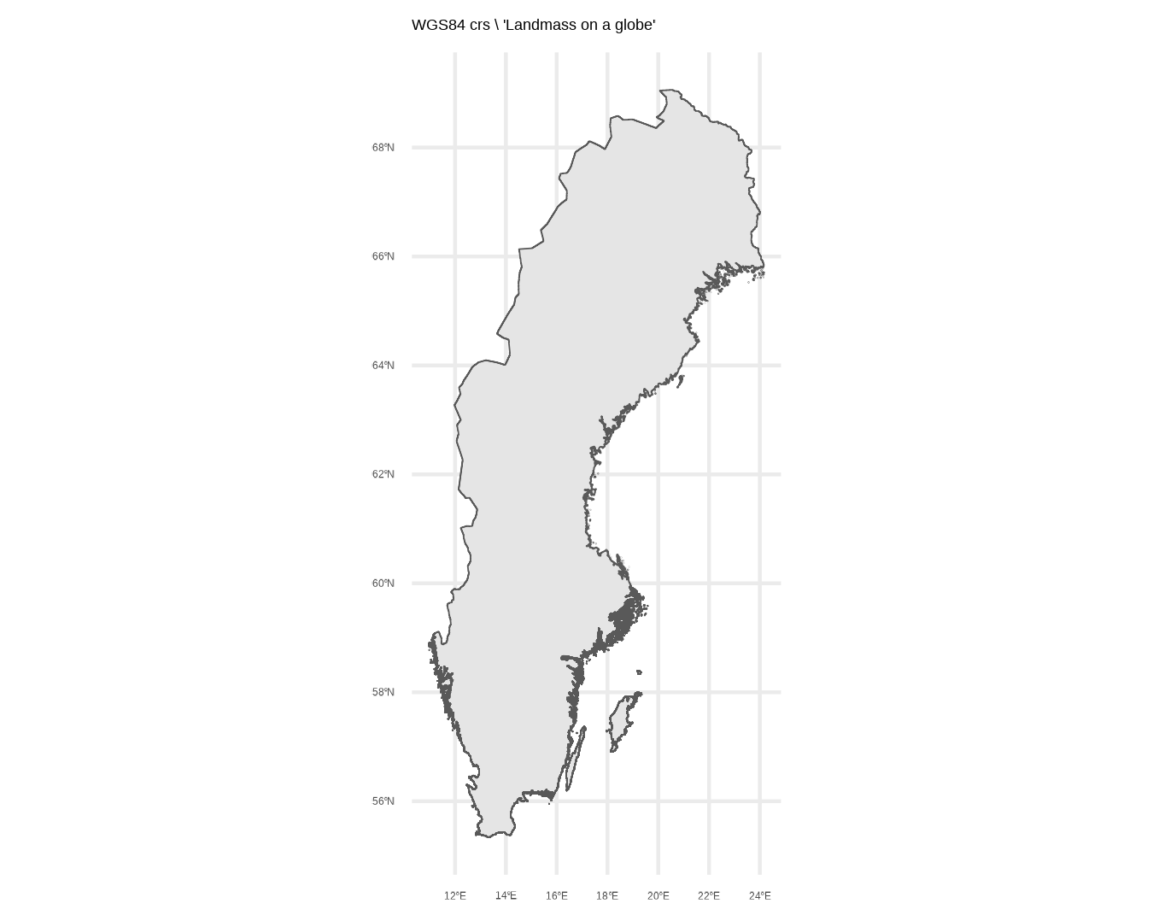
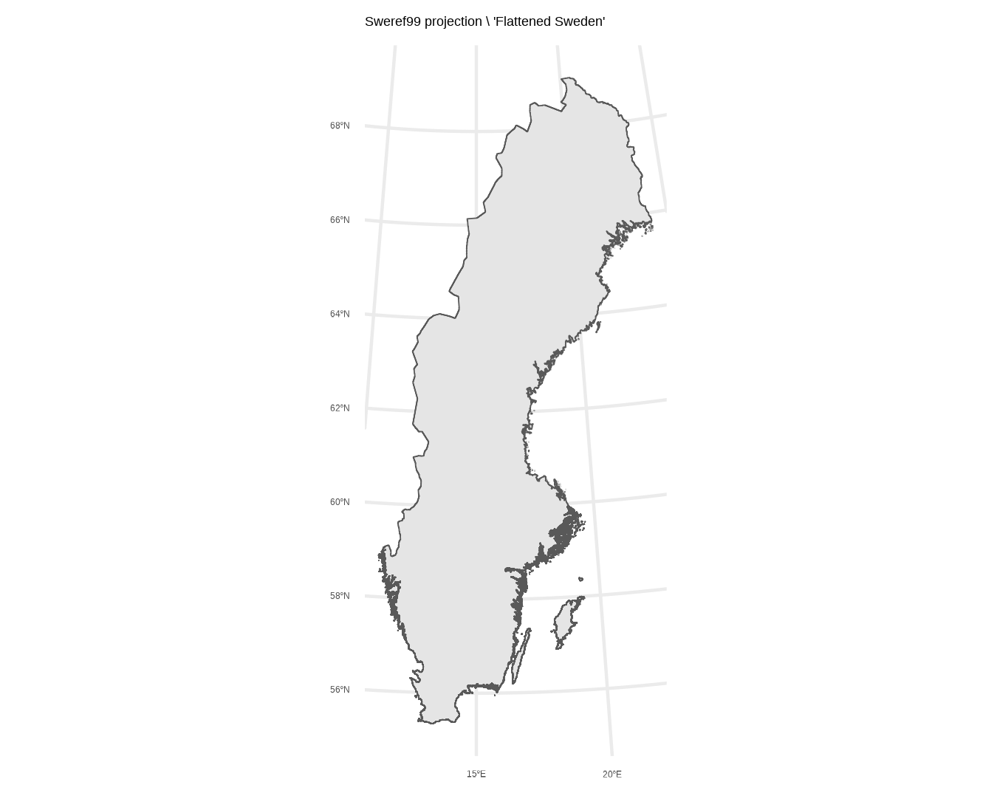
WGS84 (EPSG:4326).
Sweden on a globe
Sweref99 (EPSG: 3006).
Flat Sweden, suited for Sweden’s shape

Slide 16
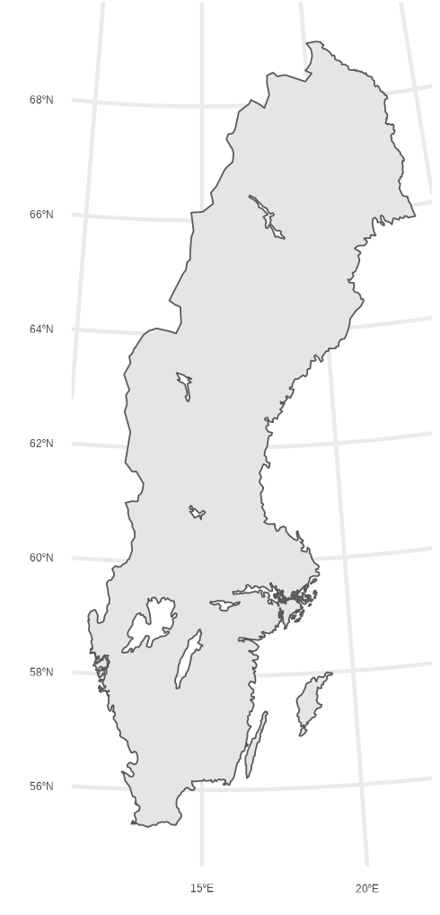
Lower resolution from swemapsdata
+ the lakes
High resolution from GADM

Slide 17
Maps are political!

Slide 18
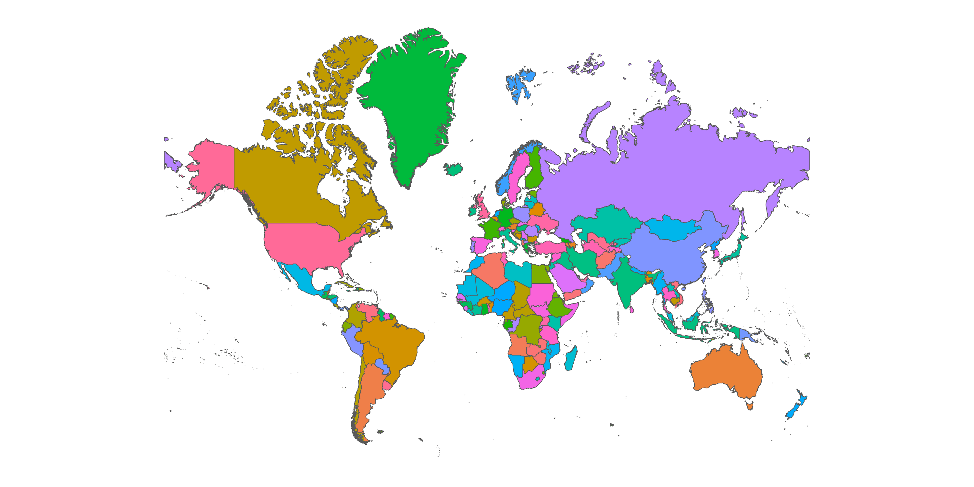
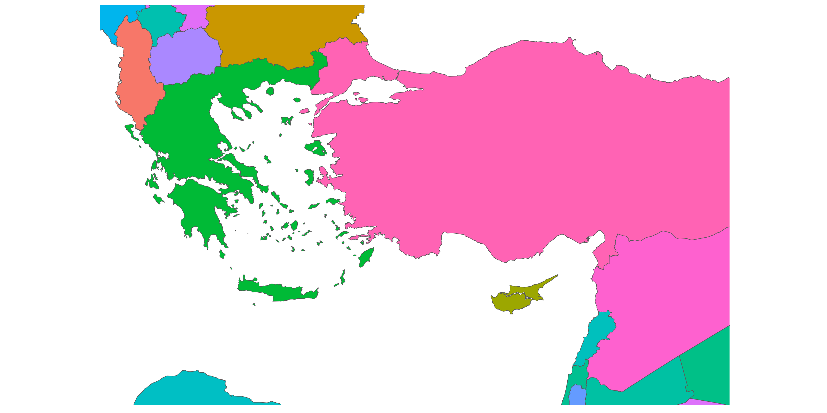
World Bank data from 2020.
(Mercator)

Slide 19
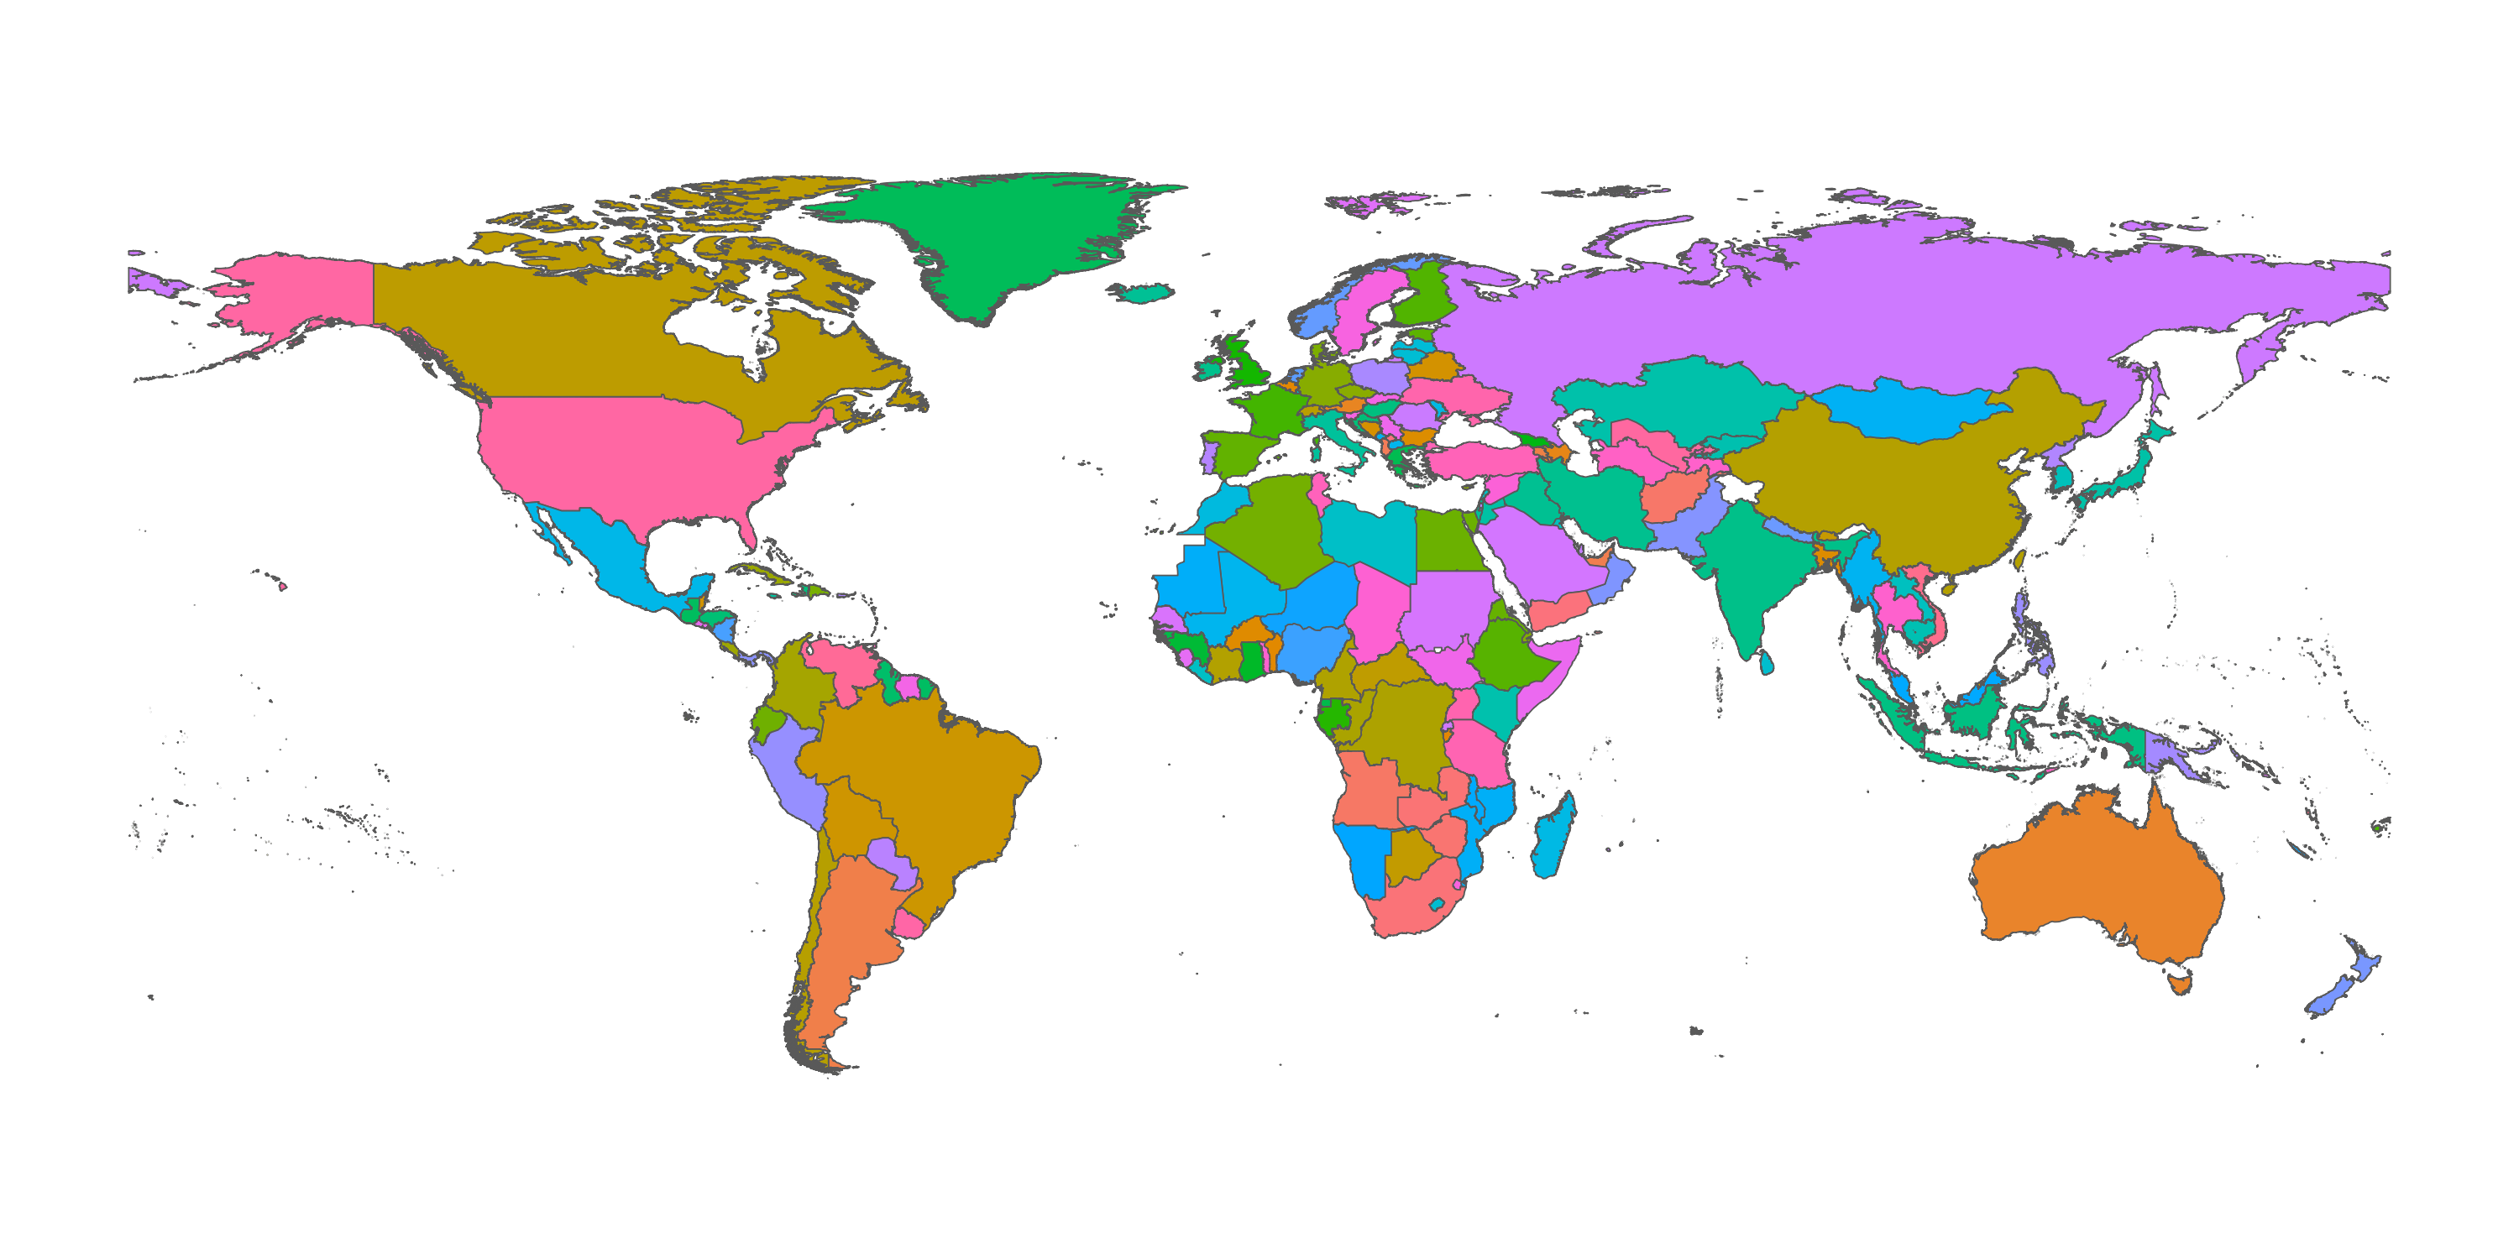
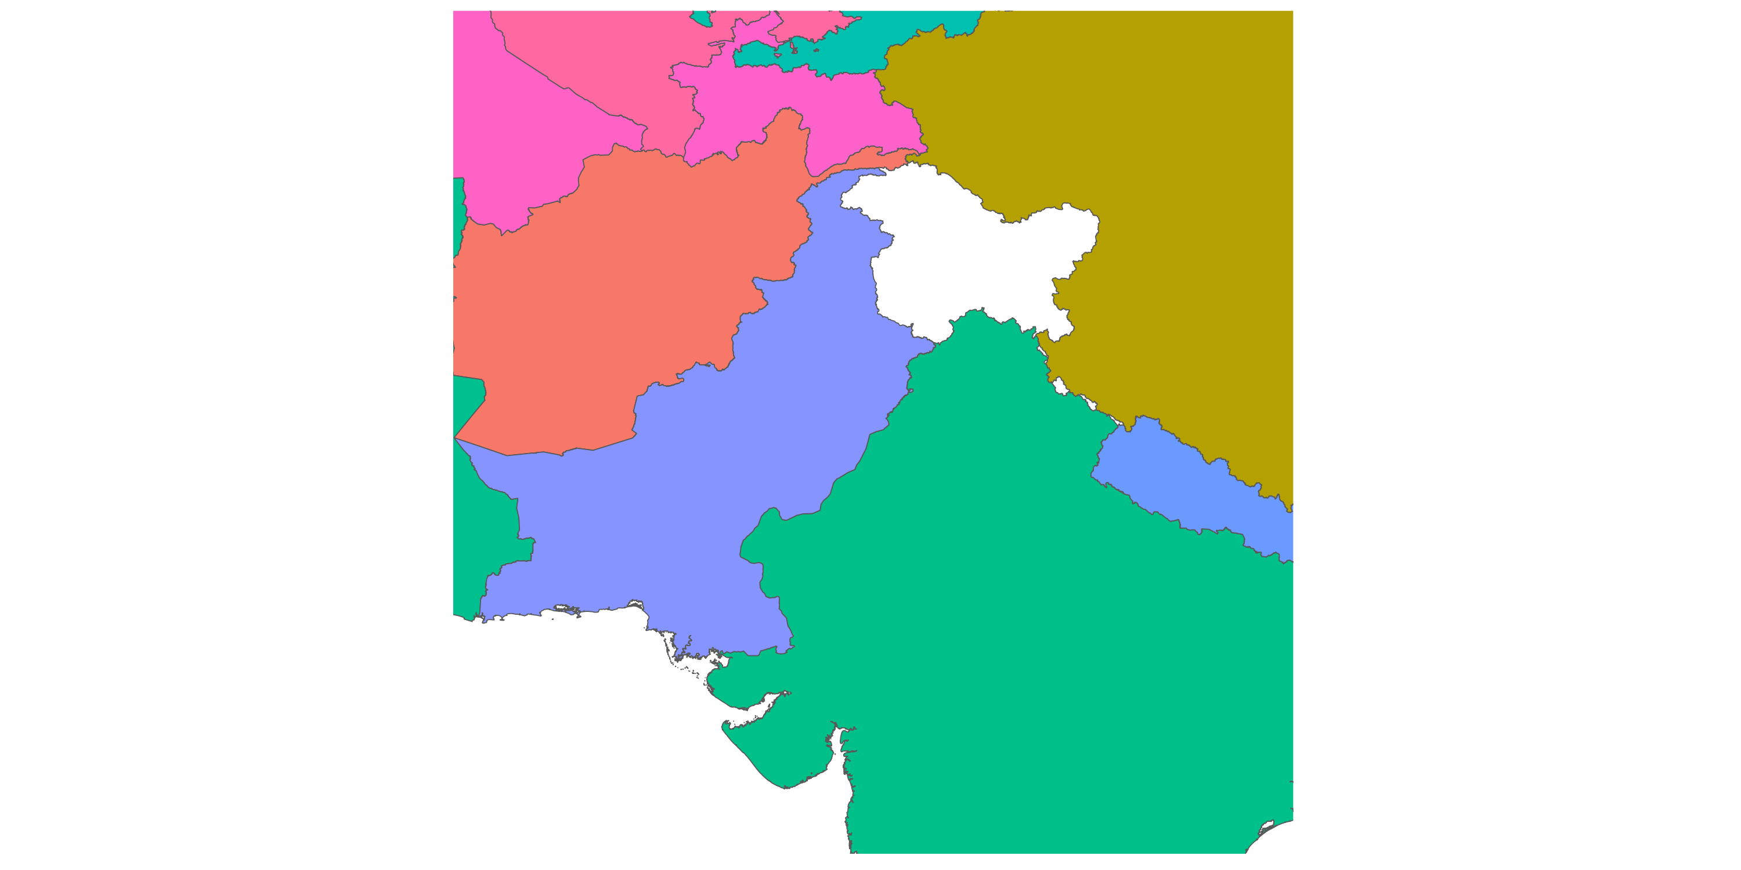
World Bank data from 2025.
(WGS84)

Slide 20
Examples of social science use of GIS

Slide 21
As variables: Using geodata instead of the names of places
Higher precision: Instead of a dummy drone strike/nature reserve within county. Which is the closest drone strike? How close?
Spatial proximity effects: How far are schools from the nearest church? Which party do students support later in life?
Spatial clustering: Is public investment clustered around certain political strongholds?
Reorganize your data by geomatching. Match municipalities to counties, or to ad hoc, theoretically relevant geographical units like reform districts etc.
Combine data through geometry. Climate disaster data as grid + geocoded local election data. Geometrical data as a key between two types of data

Slide 22
As maps: Descriptive analysis, exploration, and storytelling
Describe the geographical distribution of your data. Where do observations “happen”? How do ideas/armies/political trends spread geographically?
Explore geographical patterns in data. See trends, exceptions and outliers in their geographical context.
Find new questions by studying geographical patterns. Why here? Why not there? Why this geographical pattern despite other expectations?

Slide 23
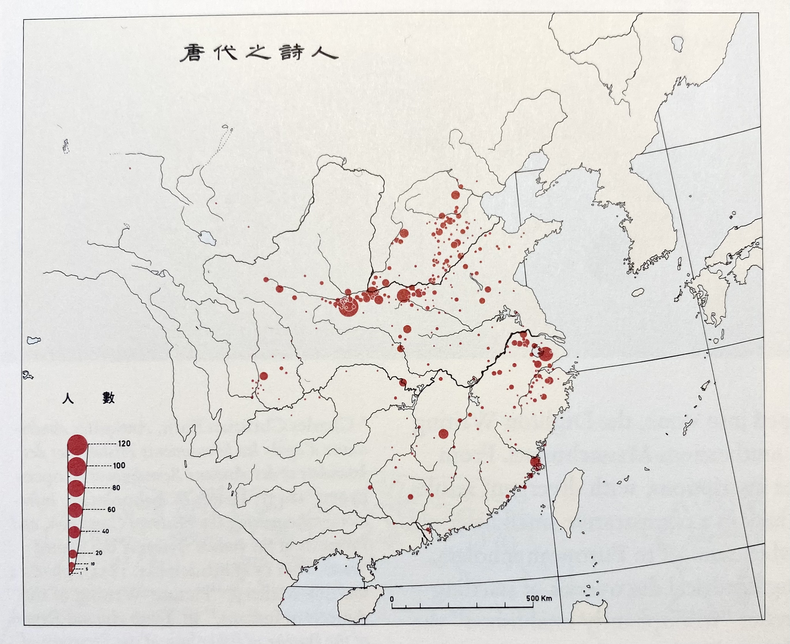
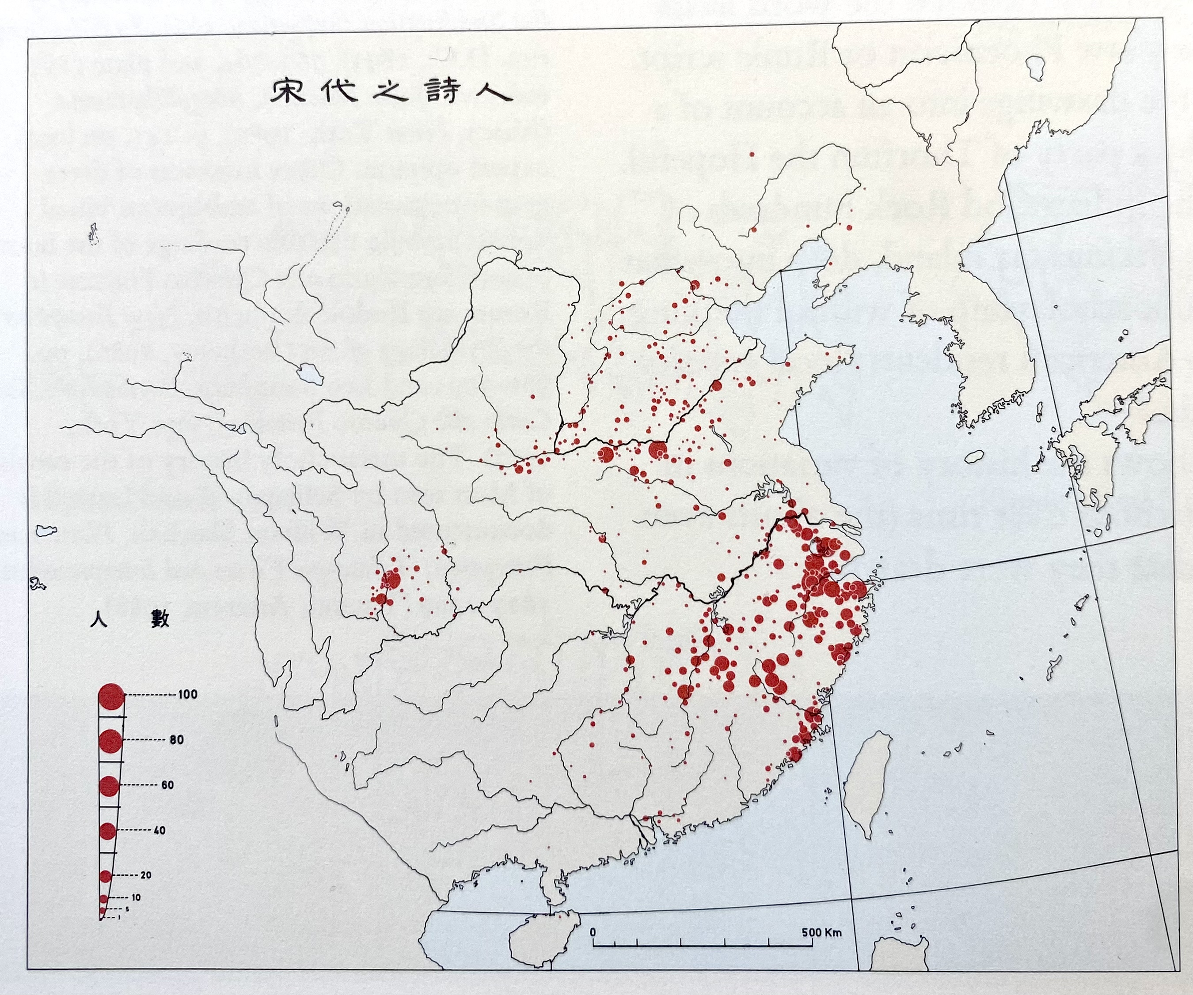
Where did poets flourish in China during the last 1000 years?
Birthplaces of the 2625 Tang poets, 618-907.
Birthplaces of the 2377 Sung poets, 969-1279.
Edward Tufte’s Envisioning Information from 1990, p. 74-75.

Slide 24
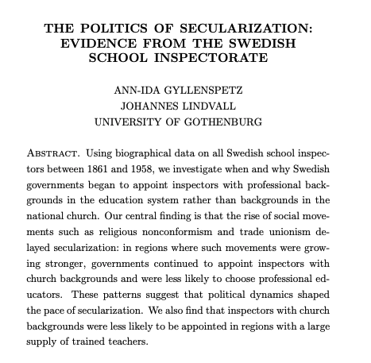

Slide 25
The Politics of Secularization 1861-1958
When and why were secular state school inspector appointed?
Secularization is not a momentous shift – Sweden eventually became secular, but the process was geographically and temporally fragmented.
Same pattern with the school inspectorate.
What did the “gradualness” look like and why?
Explanatory factors also vary geographically

Slide 26
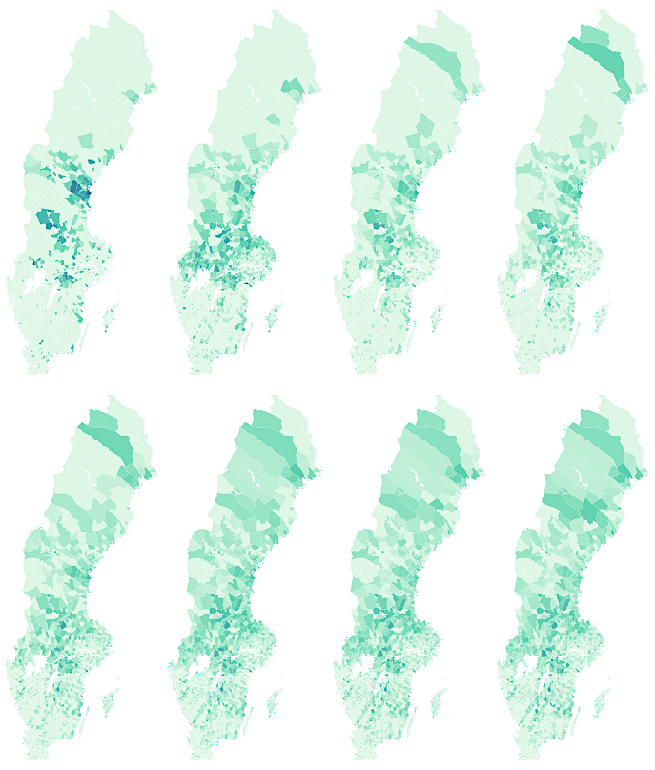
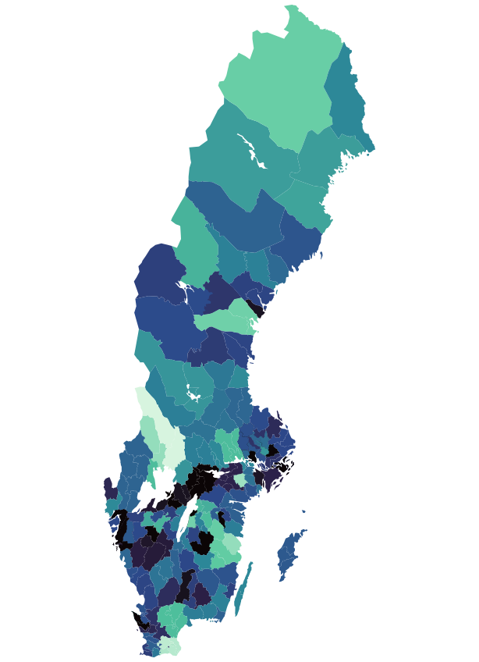
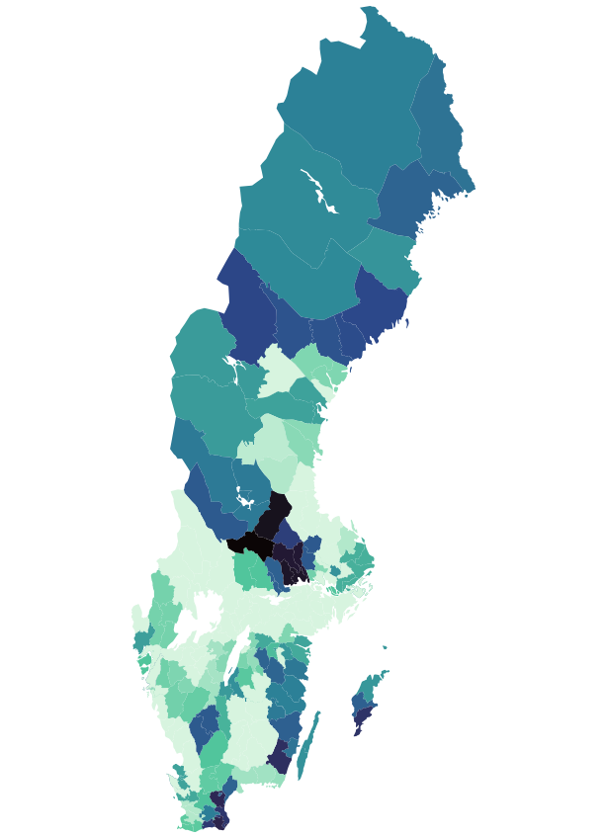
Proportion of type of school inspectors per deanery 1861-1958
Membership in free churches per parish 1881-1950 (abs. numbers)
Secular
Religious

Slide 27
The Politics of Secularization 1861-1958
Practically, we:
Build our dataset upon geodata (who, where, when? This is the difficult part)
Construct geographical variables (measure distance)
Make maps to describe the “gradualness” of secularization (secular inspectors where and when?)
More importantly:
We use GIS to tell a story of theoretical and societal relevance

Slide 28
“Advanced geospatial analysis”
Think of geometry as one more, albeit pretty nice, column in your dataset. It is what you make of it!
Advanced in my mind: Coming up with a good RQ, putting the right data in the right place in time, finding good geodata, making a compelling argument, non-spatial analysis.
The tools in e.g. SF are straightforward and can be applied in a simple or more complex analysis.
The people at QoG data do however know more about advanced stuff!

Slide 29
Where to find geographical data
World Bank https://datacatalog.worldbank.org/search/dataset/0038272/world-bank-official-boundaries
GADM https://gadm.org/data.html
Göteborgs Stad https://goteborg.se/wps/portal/enhetssida/statistik-och-analys/geografi/omradesindelningar/gisskikt-for-stadens-omradesindelning
Github https://rdrr.io/github/junkka/histmaps/ or swemapsdata
In R: leaflet, ggspatial, rnaturalearth come with some data
etcetera, etcetera.

Slide 30
Advice from people in political science who work a lot in R GIS
subset your data often to find out what operations do
visualize often to keep track
use AI as a translation tool
try st_make_valid( ) if nothing else works.
st_as_sf() can also solve problems
print the cheatsheet
according to the professionals: use gpkg instead of .shp

